Slide 1
Mathematical Preliminaries – II
(Basic Probability - I)
Lecture 2
Part 2
Generative AI for Computer Vision

Slide 2
Outline
Definitions
Random Variables
Conditional Probability and Bayes theorem
Discrete and Continuous Random Variables
Probability Density Function
Cumulative Distribution Function
Mean and Variance

Slide 3
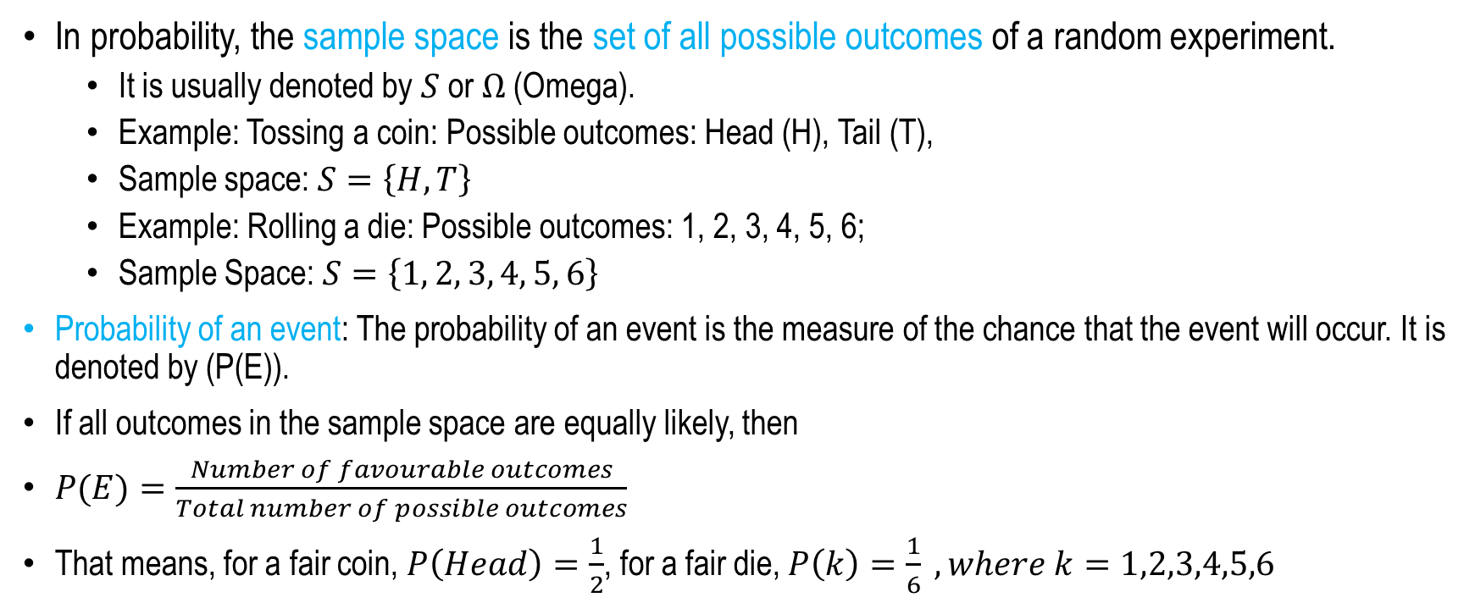
A few definitions of Probability
In probability, the sample space is the set of all possible outcomes of a random experiment.
  It is usually denoted by $S$ or $Ω$ (Omega).
  Example: Tossing a coin: Possible outcomes: Head (H), Tail (T),
  Sample space: $S=\left\{H,T\right\}$
  Example: Rolling a die: Possible outcomes: 1, 2, 3, 4, 5, 6;
  Sample Space: $S=\left\{1, 2, 3, 4, 5, 6\right\}$
Probability of an event: The probability of an event is the measure of the chance that the event will occur. It is denoted by (P(E)).
If all outcomes in the sample space are equally likely, then
$P(E)=\frac{Number of favourable outcomes}{Total number of possible outcomes}$
That means, for a fair coin, $P\left(Head\right)=\frac{1}{2}$, for a fair die, $P\left(k\right)=\frac{1}{6} , where k=1,2,3,4,5,6$

Slide 4
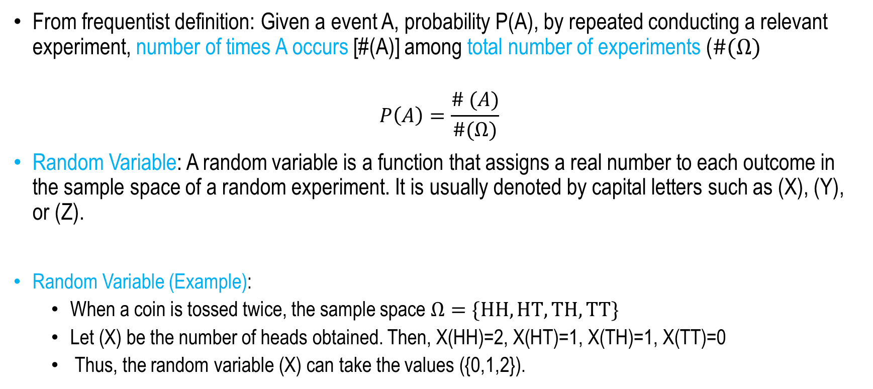
Probability and Random Variable
From frequentist definition: Given a event A, probability P(A), by repeated conducting a relevant experiment, number of times A occurs [#(A)] among total number of experiments ($\#(Ω)$
$$P\left(A\right)=\frac{\# (A)}{\#(Ω)}$$
Random Variable: A random variable is a function that assigns a real number to each outcome in the sample space of a random experiment. It is usually denoted by capital letters such as (X), (Y), or (Z).
Random Variable (Example):
  When a coin is tossed twice, the sample space $Ω=\{HH, HT,TH,TT\}$
  Let (X) be the number of heads obtained. Then, X(HH)=2, X(HT)=1, X(TH)=1, X(TT)=0
  Thus, the random variable (X) can take the values ({0,1,2}).

Slide 5
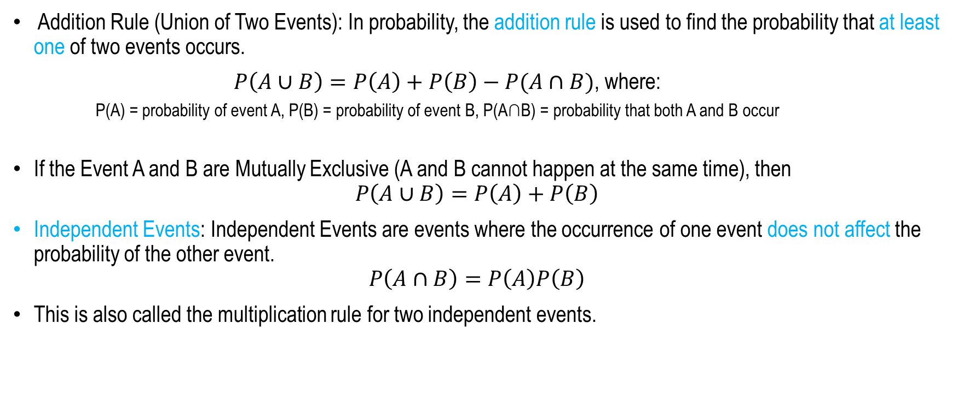
Probability Rules
Addition Rule (Union of Two Events): In probability, the addition rule is used to find the probability that at least one of two events occurs.
$P\left(A∪B\right)=P\left(A\right)+P\left(B\right)−P(A∩B)$, where:
  P(A) = probability of event A, P(B) = probability of event B, P(A∩B) = probability that both A and B occur
If the Event A and B are Mutually Exclusive (A and B cannot happen at the same time), then
$$P\left(A∪B\right)=P\left(A\right)+P\left(B\right)$$
Independent Events: Independent Events are events where the occurrence of one event does not affect the probability of the other event.
$$P\left(A∩B\right)=P\left(A\right)P\left(B\right)$$
This is also called the multiplication rule for two independent events.

Slide 6
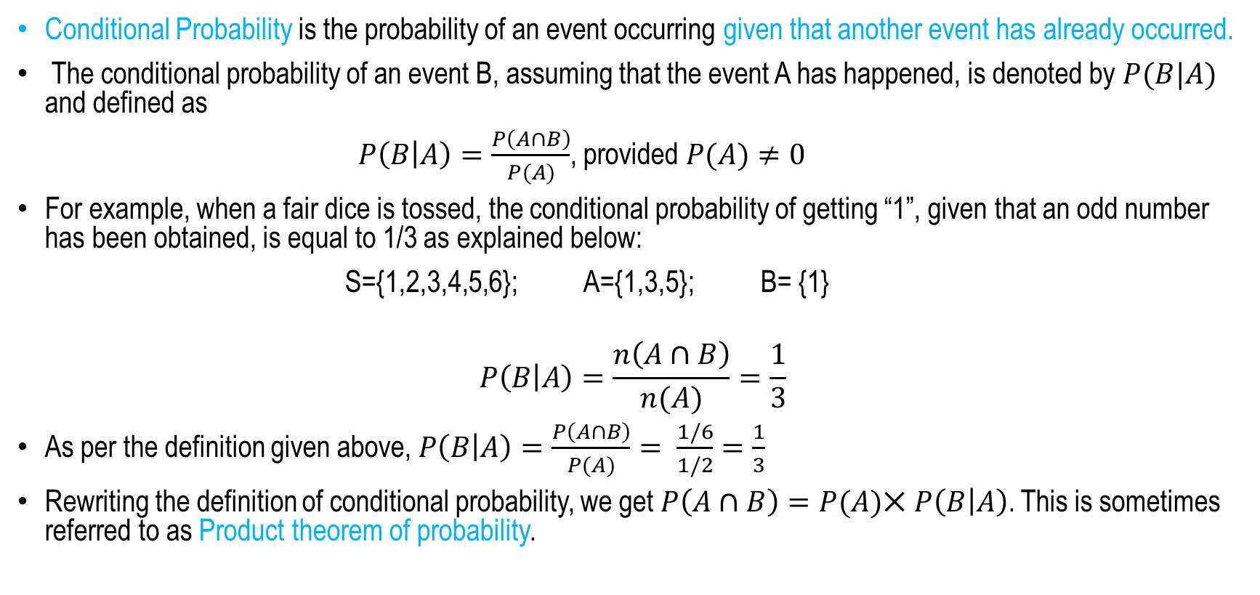
Conditional Probability
Conditional Probability is the probability of an event occurring given that another event has already occurred.
The conditional probability of an event B, assuming that the event A has happened, is denoted by $P(B|A)$ and defined as
$P\left(B | A\right)=\frac{P\left(A∩B\right)}{P(A)}$, provided $P(A)≠0$
For example, when a fair dice is tossed, the conditional probability of getting “1”, given that an odd number has been obtained, is equal to 1/3 as explained below:
S={1,2,3,4,5,6}; A={1,3,5}; B= {1}
$$P\left(B | A\right)=\frac{n\left(A∩B\right)}{n(A)}=\frac{1}{3}$$
As per the definition given above, $P\left(B | A\right)=\frac{P\left(A∩B\right)}{P(A)}= \frac{1/6}{1/2}=\frac{1}{3}$
Rewriting the definition of conditional probability, we get $P\left(A∩B\right)=P(A)⨉$ $P\left(B | A\right)$. This is sometimes referred to as Product theorem of probability.

Slide 7
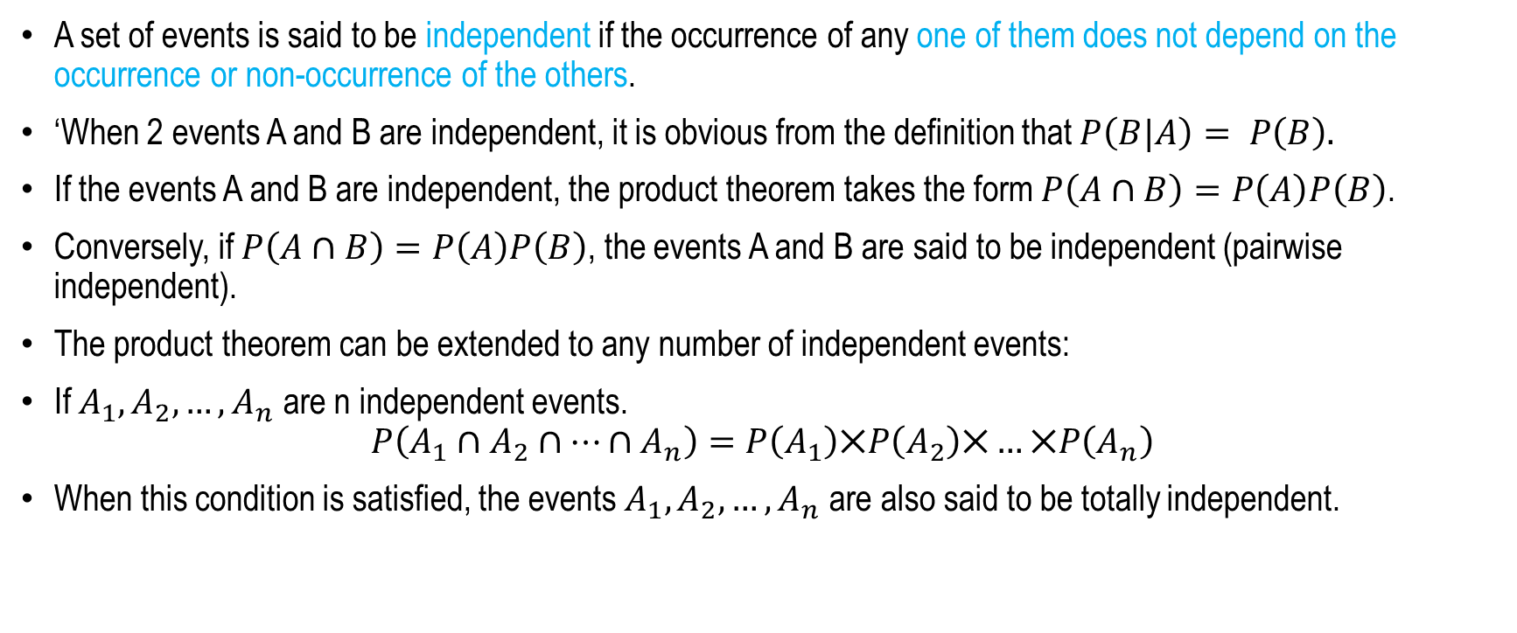
Independent Events
A set of events is said to be independent if the occurrence of any one of them does not depend on the occurrence or non-occurrence of the others.
‘When 2 events A and B are independent, it is obvious from the definition that $P\left(B|A\right)= P\left(B\right).$
If the events A and B are independent, the product theorem takes the form $P\left(A∩B\right)=P\left(A\right)P\left(B\right)$.
Conversely, if $P\left(A∩B\right)=P\left(A\right)P\left(B\right)$, the events A and B are said to be independent (pairwise independent).
The product theorem can be extended to any number of independent events:
If $A_{1},A_{2}, …, A_{n}$ are n independent events.
$$P\left(A_{1}∩A_{2}∩⋯∩A_{n}\right)=P\left(A_{1}\right)⨉P\left(A_{2}\right)⨉…⨉P\left(A_{n}\right)$$
When this condition is satisfied, the events $A_{1},A_{2}, …, A_{n}$ are also said to be totally independent.

Slide 8
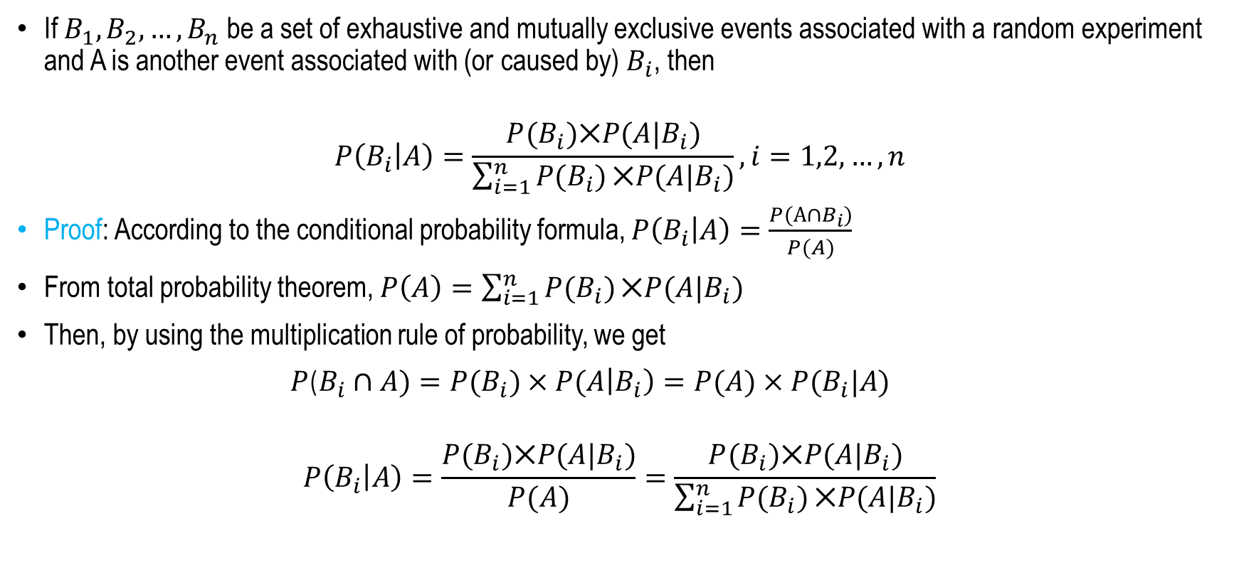
Bayes Theorem
If $B_{1},B_{2}, …, B_{n}$ be a set of exhaustive and mutually exclusive events associated with a random experiment and A is another event associated with (or caused by) $B_{i}$, then
$$P\left(B_{i} | A\right)=\frac{P(B_{i})⨉P(A|B_{i})}{\sum_{i=1}^{n}{P(B_{i})}⨉P(A|B_{i})}, i=1,2,…,n$$
Proof: According to the conditional probability formula, $P\left(B_{i} | A\right)=\frac{P(A∩B_{i})}{P(A)}$
From total probability theorem, $P\left(A\right)=\sum_{i=1}^{n}{P(B_{i})}⨉P(A|B_{i})$
Then, by using the multiplication rule of probability, we get
$P$($B_{i}∩A)=P(B_{i})×P(A\left|B_{i}\right)=P(A)×P(B_{i}|A)$
$$P\left(B_{i} | A\right)=\frac{P(B_{i})⨉P(A|B_{i})}{P(A)}=\frac{P(B_{i})⨉P(A|B_{i})}{\sum_{i=1}^{n}{P(B_{i})}⨉P(A|B_{i})}$$

Slide 9
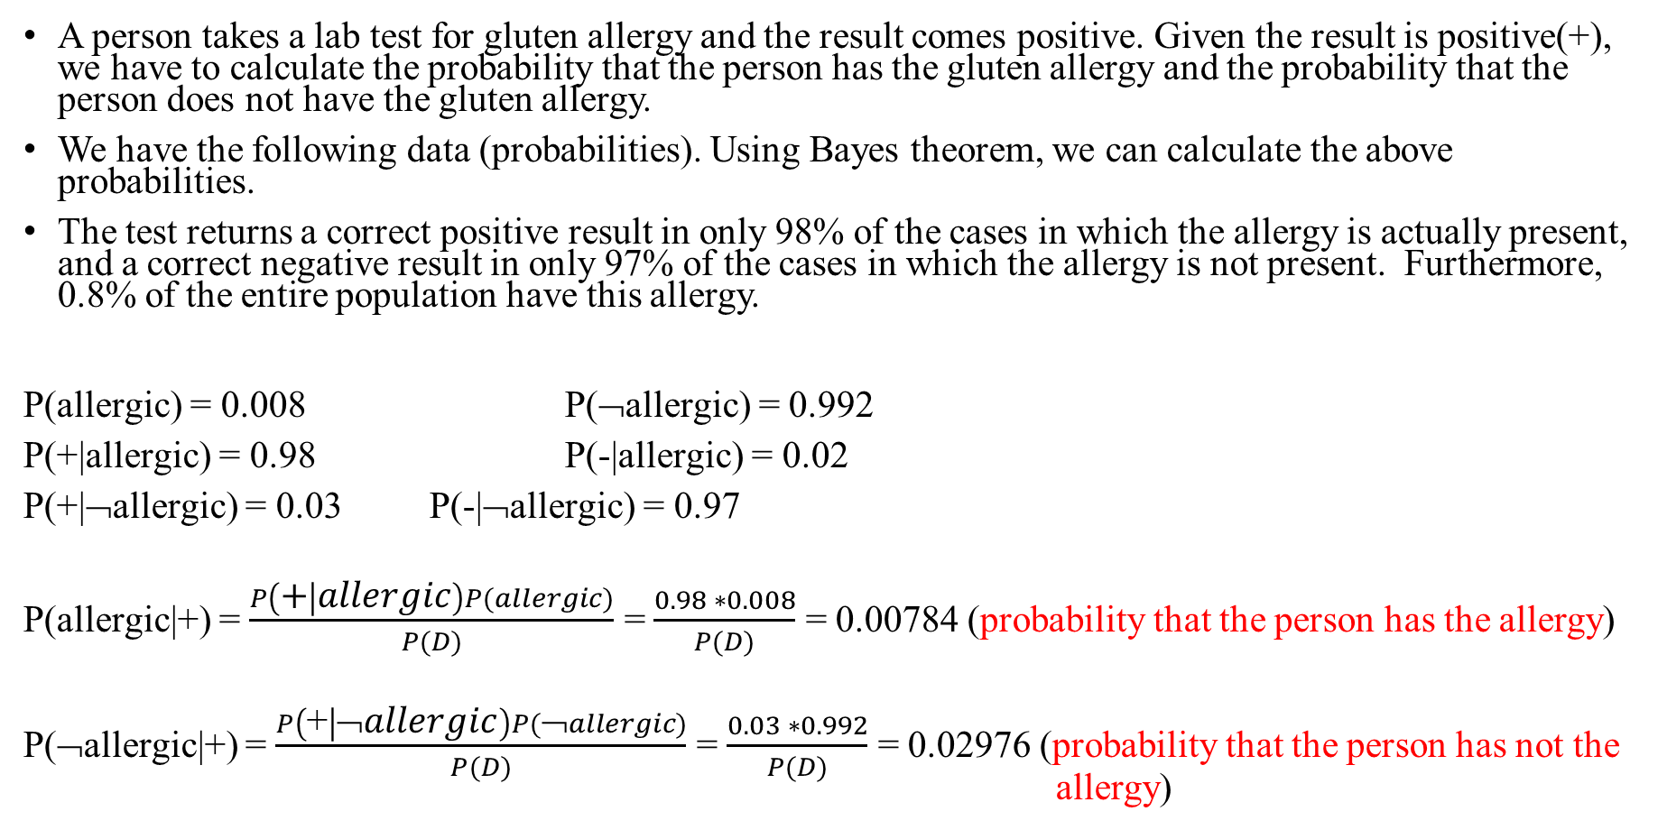
Application of Bayes Theorem
A person takes a lab test for gluten allergy and the result comes positive. Given the result is positive(+), we have to calculate the probability that the person has the gluten allergy and the probability that the person does not have the gluten allergy.
We have the following data (probabilities). Using Bayes theorem, we can calculate the above probabilities.
The test returns a correct positive result in only 98% of the cases in which the allergy is actually present, and a correct negative result in only 97% of the cases in which the allergy is not present. Furthermore, 0.8% of the entire population have this allergy.
P(allergic) = 0.008 P(¬allergic) = 0.992
P(+|allergic) = 0.98 P(-|allergic) = 0.02
P(+|¬allergic) = 0.03 P(-|¬allergic) = 0.97
P(allergic|+) = $\frac{P\left(+ | allergic\right)P(allergic)}{P(D)}$ = $\frac{0.98 ∗0.008}{P(D)}$ = 0.00784 (probability that the person has the allergy)
P(¬allergic|+) = $\frac{P\left(\text{+} | \text{➢}allergic\right)P(\text{➢}allergic)}{P(D)}$ = $\frac{0.03 ∗0.992}{P(D)}$ = 0.02976 (probability that the person has not the allergy)

Slide 10
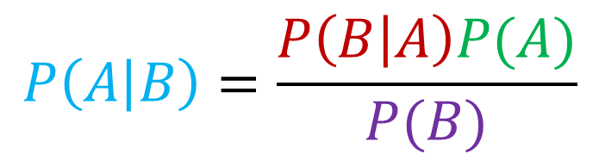
Bayes Theorem
Likelihood
Prior probability
$$P\left(A | B\right)=\frac{P\left(B | A\right)P(A)}{P(B)}$$
posterior probability
Evidential probability
P(A): Prior probability: The prior probability of event A, denoted by P(A), is the probability of A occurring before knowing whether event B has occurred or not. Here, A is treated as a proposition or hypothesis, and B represents evidence that may later be used to update the probability of A.
P(B) = Evidential probability: the probability pf the evidential event B.
P(A|B) = Posterior probability: The probability of proposition or hypothesis A post the occurrence of the evidential event B.
P(B|A) = Likelihood: how likely the evidence B is, given that proposition A has occurred.

Slide 11
Probability and Random Variable
There are two types of random variables:
  Discrete Random Variable – Takes a finite or countable number of values (e.g., the number of heads obtained when tossing three coins).
  Continuous Random Variable – Takes any value within a given interval (e.g., the height or weight of a person).

Slide 12





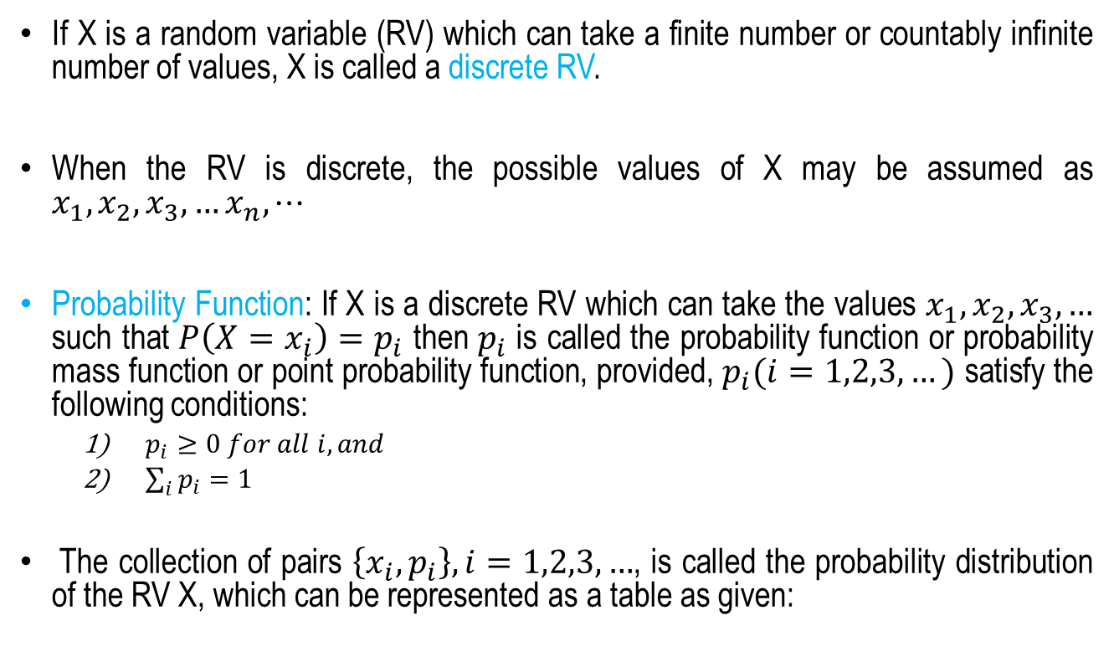







Discrete Random Variable
If X is a random variable (RV) which can take a finite number or countably infinite number of values, X is called a discrete RV.
When the RV is discrete, the possible values of X may be assumed as $x_{1},x_{2},x_{3},…x_{n},⋯$
Probability Function: If X is a discrete RV which can take the values $x_{1},x_{2},x_{3},…$ such that $P\left(X=x_{i}\right)=p_{i}$ then $p_{i}$ is called the probability function or probability mass function or point probability function, provided, $p_{i}(i=1,2,3,…)$ satisfy the following conditions:
  $p_{i}≥0 for all i, and$
  $\sum_{i}{p_{i}=1}$
The collection of pairs $\left\{x_{i},p_{i}\right\}, i=1,2,3,…$, is called the probability distribution of the RV X, which can be represented as a table as given:
$$X=x_{i}$$
$$P(X=x_{i})$$
$$x_{1}$$
$$p_{1}$$
$$x_{2}$$
$$p_{2}$$
$$⋮$$
$$⋮$$
$$x_{k}$$
$$p_{k}$$
$$⋮$$
$$⋮$$
Source: Probability, Statistics and Random Processes, T Veerarajan, Tata McGraw-Hill Publishing Company Limited

Slide 13

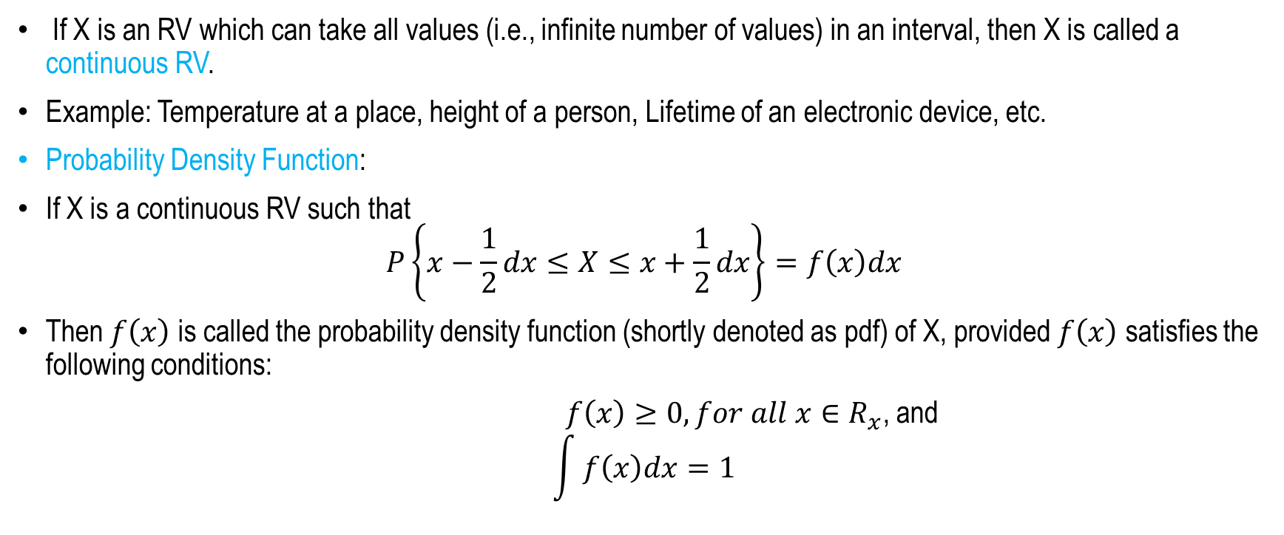
Continuous Random Variable and Probability Density Function
If X is an RV which can take all values (i.e., infinite number of values) in an interval, then X is called a continuous RV.
Example: Temperature at a place, height of a person, Lifetime of an electronic device, etc.
Probability Density Function:
If X is a continuous RV such that
$$P\left\{x−\frac{1}{2}dx≤X≤x+\frac{1}{2}dx\right\}=f\left(x\right)dx$$
Then $f\left(x\right)$ is called the probability density function (shortly denoted as pdf) of X, provided $f\left(x\right)$ satisfies the following conditions:
$f\left(x\right)≥0, for all x∈R_{x}$, and
$$\int{f\left(x\right)dx=1}$$
$$R_{x}$$

Slide 14
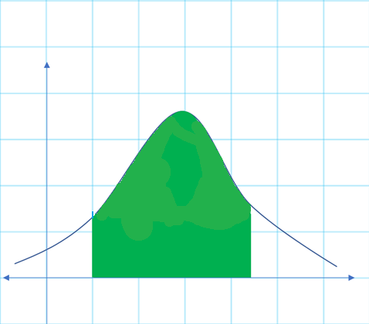







Probability Density Function
Moreover, $P(a≤X≤b)$ or $P\left(a<X<b\right)$ is defined as
$$P\left(a≤X≤b\right)=\int_{a}^{b}{f\left(x\right)dx}$$
The curve $y=f(x)$ is called the probability curve of the RV X.
$$f\left(x\right)$$
$P(a≤X≤b$)
$$0$$
$$X=a$$
$$X=b$$
$$x$$

Slide 15
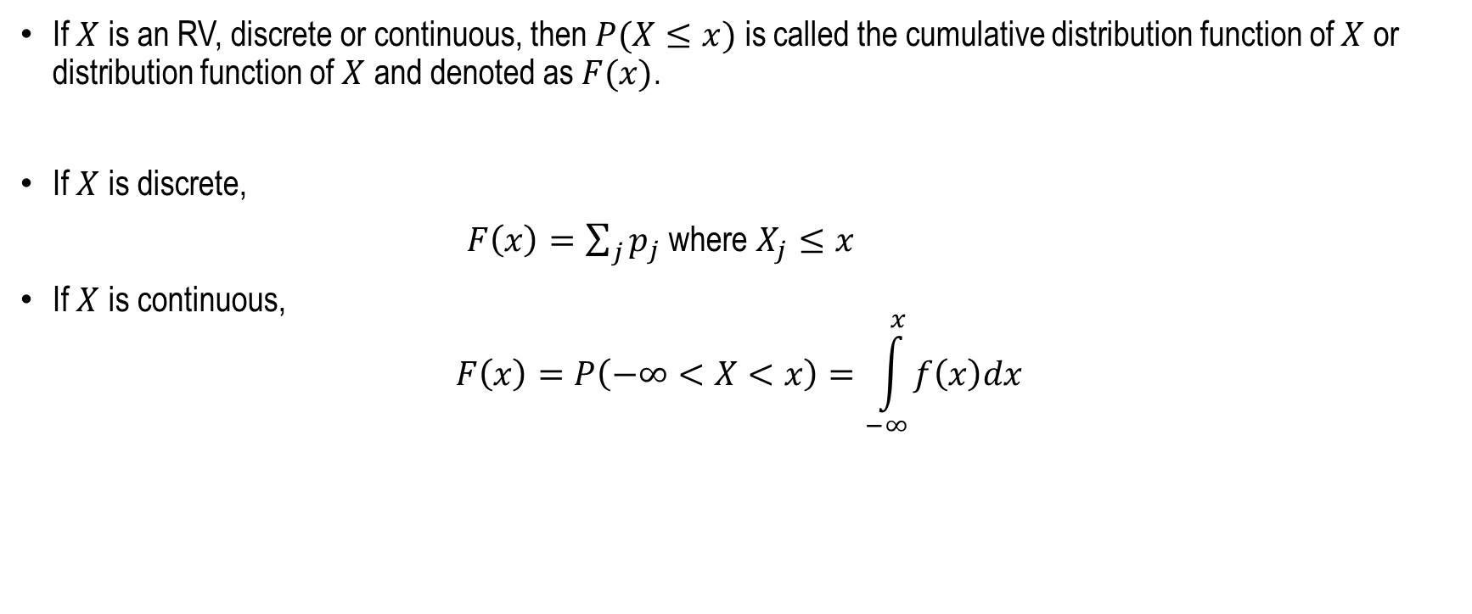
Cumulative Distribution Function (cdf)
If $X$ is an RV, discrete or continuous, then $P(X≤x)$ is called the cumulative distribution function of $X$ or distribution function of $X$ and denoted as $F(x)$.
If $X$ is discrete,
$F\left(x\right)=\sum_{j}{p_{j}}$ where $X_{j}≤x$
If $X$ is continuous,
$$F\left(x\right)=P\left(−∞<X<x\right)=\int_{−∞}^{x}{f\left(x\right)dx}$$

Slide 16
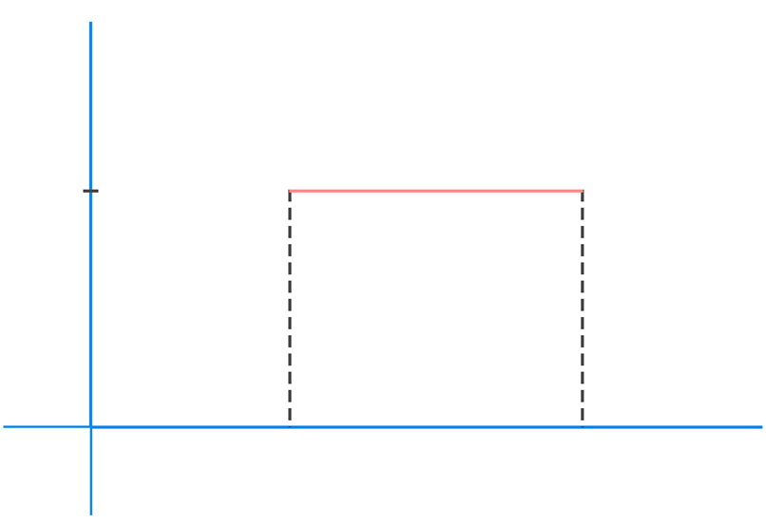
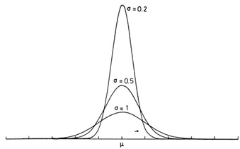


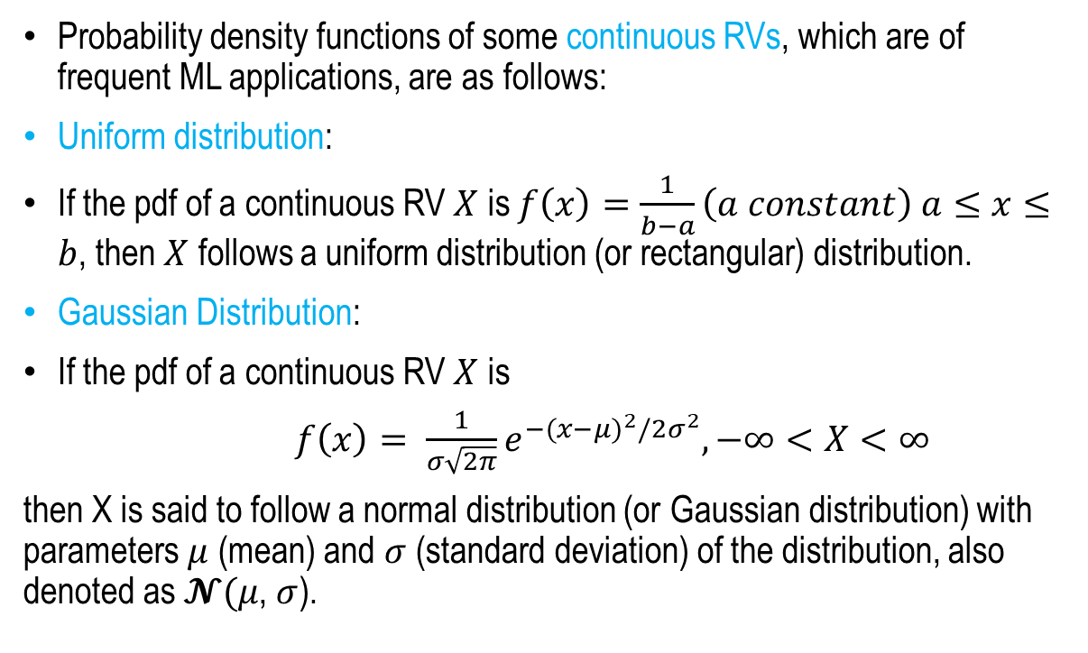

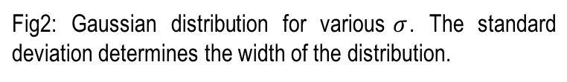


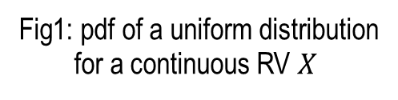
Some useful PDFs in ML
$$f\left(x\right)$$
$$\frac{1}{b−a}$$
Probability density functions of some continuous RVs, which are of frequent ML applications, are as follows:
Uniform distribution:
If the pdf of a continuous RV $X$ is $f\left(x\right)=\frac{1}{b−a}\left(a constant\right) a≤x≤b$, then $X$ follows a uniform distribution (or rectangular) distribution.
Gaussian Distribution:
If the pdf of a continuous RV $X$ is
$f\left(x\right)= \frac{1}{σ\sqrt{2π}}e^{−{(x−μ)}^{2}/2σ^{2}},−∞<X<∞$
then X is said to follow a normal distribution (or Gaussian distribution) with parameters $μ$ (mean) and $σ$ (standard deviation) of the distribution, also denoted as $𝓝(μ$, $σ$).
$$a$$
$$x$$
$$b$$
Fig1: pdf of a uniform distribution
for a continuous RV $X$
Fig2: Gaussian distribution for various$σ$. The standard deviation determines the width of the distribution.
Fig2: Source: https://ned.ipac.caltech.edu/level5/Leo/Stats2_3.html

Slide 17

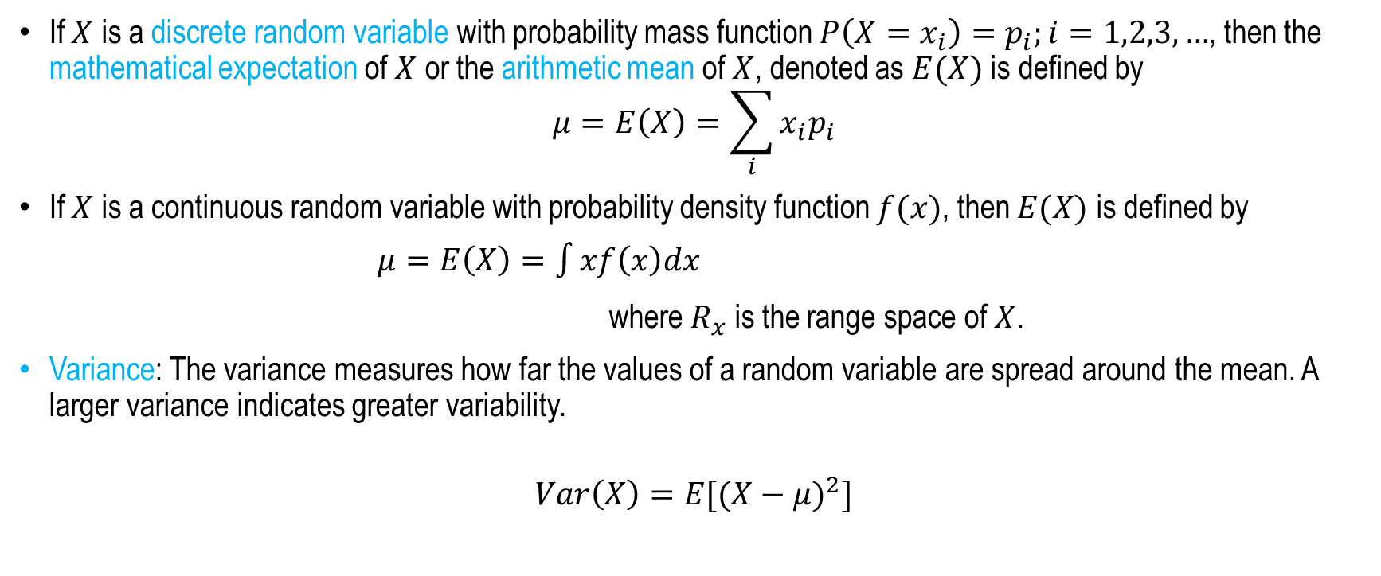
Mean and Variance
If $X$ is a discrete random variable with probability mass function $P\left(X=x_{i}\right)=p_{i};i=1,2,3,…$, then the mathematical expectation of $X$ or the arithmetic mean of $X$, denoted as $E(X)$ is defined by
$$μ=E\left(X\right)=\sum_{i}{x_{i}p_{i}}$$
If $X$ is a continuous random variable with probability density function $f(x)$, then $E(X)$ is defined by
$μ=E\left(X\right)=\int{xf\left(x\right)dx}$
where $R_{x}$ is the range space of $X$.
Variance: The variance measures how far the values of a random variable are spread around the mean. A larger variance indicates greater variability.
$$Var\left(X\right)=E[{(X−μ)}^{2}]$$
$R_{x}$

Slide 18
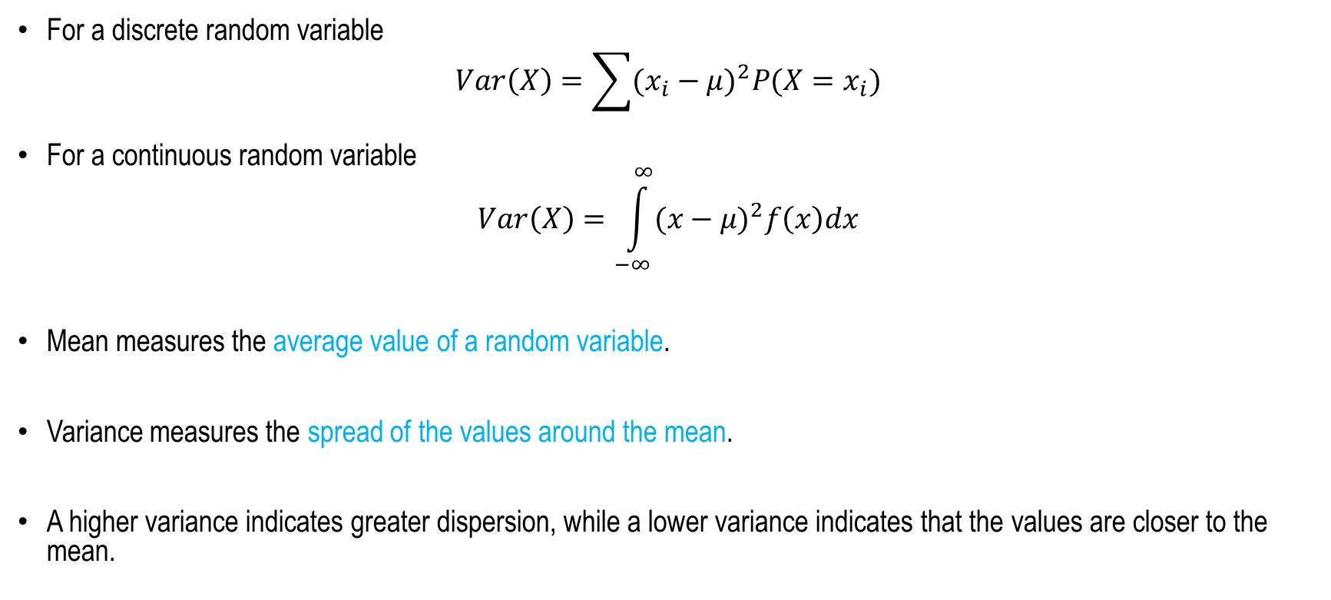
Mean and Variance
For a discrete random variable
$$Var\left(X\right)=\sum{{(x_{i}−μ)}^{2}P(X=x_{i})}$$
For a continuous random variable
$$Var\left(X\right)=\int_{−∞}^{∞}{{(x−μ)}^{2}f\left(x\right)dx}$$
Mean measures the average value of a random variable.
Variance measures the spread of the values around the mean.
A higher variance indicates greater dispersion, while a lower variance indicates that the values are closer to the mean.

Slide 19
Summary
Definitions
Random Variables
Conditional Probability and Bayes theorem
Discrete and Continuous Random Variables
Probability Density Function
Cumulative Distribution Function
Mean and Variance

Slide 20
Mathematical Preliminaries – II
(Basic Probability)
Next
Lecture 2:Part 3
Generative AI for Computer Vision

